Slide 1
2026-27 Proposed Adopted
Budget Report
PRESENTED TO THE BOARD OF TRUSTEES – FOR PUBLIC HEARING
June 16, 2026
Kate Ingersoll
& Executive Director
Fiscal Services
By Ryan DiGiulio
Chief Business Official

Slide 2
Agenda
Strategic Framework and Roadmap to College and Career Ready
The Budget Reporting Cycle
May Revision Overview
Proposed 2026-27 Adopted Budget
  Budget Projection – Key Factors
  SACS Budget Forms
  2026-27 Other Funds
  2026-27 General Fund
  General Fund Multi-Year Projection
One-time Block Grant Funds
Looking Ahead

Slide 3
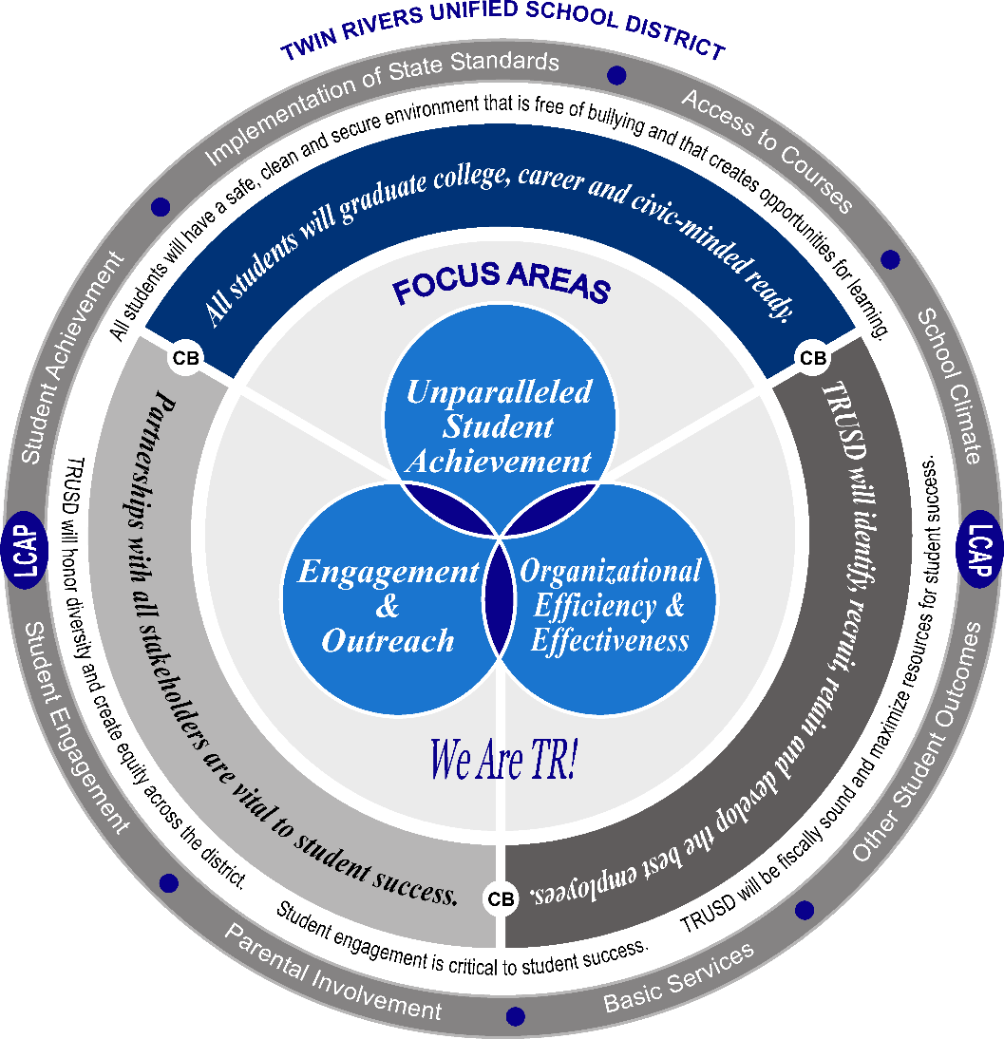
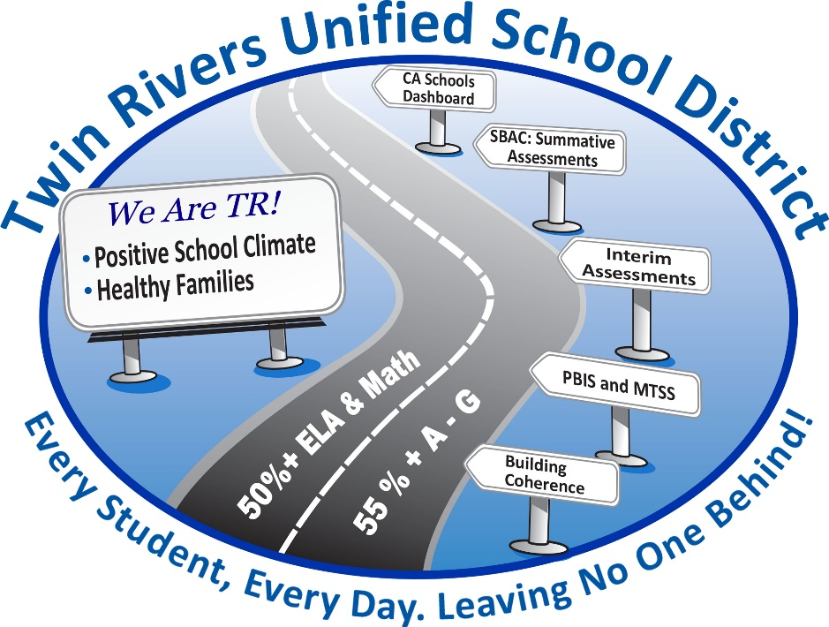
Strategic Framework and
Roadmap to College and Career Ready

Slide 4
The Budget Reporting Cycle
LCAP/
Adopted Budget
2026-27
Unaudited Actuals
2025-26
LCAP/
Adopted Budget
2027-28
Governor’s Budget Proposal
& TRUSD Staffing
2027-28
Develop LCAP/ Budget
2027-28
May Revision
2027-28
1st Interim Financial Report
2026-27
2nd Interim Financial Report
2026-27
We Are Here!
June
July
September
LCAP
December
April-May
January
March

Slide 5
2026-27
May Revision Proposal

Slide 6

Themes for the 2026-27 May Revision
  Projects significant personal income tax (PIT) growth fueled by capital gains in the current year and moderating in the budget year
    This eliminates projected ongoing deficits while providing budget stability that will last after he leaves office, if his forecast holds
Tax
Revenue
  Proposes a new benefit to local educational agency (LEA) employees of paid pregnancy disability leave (PPDL), which he proposes to fund through the Local Control Funding Formula (LCFF)
Inflation
Economic
Growth
  Shores up existing programs instead of creating new ones and provides significant one-time discretionary fund preparing education for a rainy day
  Provides an historic increase to special education funding that surpasses the statewide equalized funding rate proposed in January
  Continues his plan to under appropriate the Proposition 98 minimum guarantee to the tune of
  $3.9 billion
Job
Growth
Structural Balance
Unemployment

Slide 7
Gross Domestic Product and Artificial Intelligence
U.S. gross domestic product (GDP) growth has remained positive despite slowing hiring and elevated uncertainty
Artificial intelligence (AI) infrastructure investment has accelerated rapidly since 2023, and capital expenditures in AI are projected to represent approximately 2% of GDP in 2026
California continues to lead the nation in technology employment and venture capital investment
Source: Federal Reserve Economic Data (FRED); Epoch AI using the U.S. Securities and Exchange Commission filings; Visual Capitalist; UCLA Anderson Forecast

Slide 8
Middle East Conflict and Gas Prices
Geopolitical instability is increasing oil and gasoline prices, creating inflation pressure
California drivers pay ~$1.50-$1.70 more per gallon than the U.S. average
Source: U.S. Energy Information Administration

Slide 9
The End of the Powell Era—Future Independence of the Federal Reserve
Inflation remains above target and sensitive to external shocks
Market expectations reflect uncertainty about future policy
Leadership transition adds risk to the policy outlook
End of Powell Term
Source: FRED, FedWatch

Slide 10
The Stock Market
Supreme Court Tariff Ruling
Engagement in Middle East Conflict
U.S. Crude Oil
Closes over $100
Source: FRED

Slide 11
Historical Stock Market Downturns and State Revenues
California’s tax structure is highly dependent on stock market earnings
Technology-sector downturns have historically caused significant revenue losses
AI-driven market gains may also increase future revenue volatility
Year | What Happened? | S&P 500 Peak-to-Trough | Time to Recover Previous High
1973 | Organization of the Petroleum Exporting Countries (OPEC) oil embargo | −43% | 90 months
1981 | Federal Reserve (Fed) raised interest rates to historic highs to address stagflation | −22% | 24 months
1987 | Black Monday | −22% | 23 months
1990 | Iraq invades Kuwait, sending oil prices higher and affecting confidence | −17% | 7 months
2000 | Investors slowly realize that internet startups are overvalued | −45% | 91 months
2008 | Mortgage finance systems sets off global financial market recession | −52% | 48 months
2022 | Fed raised interest rates quickly in response to pandemic-era inflation, making borrowing expensive and deflating asset prices | −22% | 24 months
Source: Legislative Analyst’s Office (LAO)

Slide 12
California’s Bifurcated Economy
AI/Technology-Driven Growth
Broader California Economy
Unemployment has remained above the national average despite statewide economic growth
Housing affordability, elevated interest rates, and slower construction activity are weighing on broader economic conditions, which remain uneven across industries, regions, and income levels
Total nonfarm employment growth has remained modest, with several industries experiencing slower hiring and continued restructuring
California continues to receive a disproportionate share of national AI and venture capital investment, which continues to support economic output and productivity growth
  Technology-intensive industries generate disproportionate economic and fiscal impacts relative to their share of total employment
The Department of Finance (DOF) projects personal income growth will remain strong due in part to high-income technology and financial-sector earnings
“California’s new bifurcated economy is not one between East and West, but one between AI, Aerospace, and the like, and the rest of the economy.” —UCLA Anderson Forecast

Slide 13
“Big Three” Taxes
PIT continues to drive the majority of General Fund revenue growth
PIT revenues in the May Revision are projected to be $13.5 billion above the Governor’s Budget across the budget window

Slide 14
Personal Income Tax
Small upgrade as capital gains
projected to decline from
unsustainable high 2025 levels
$3.4
$9.0
$1.1

Slide 15
State General Fund Revenues
Includes only revenues that affect calculation of Prop 98 minimum guarantee
(Dollars in Billions)

Slide 16
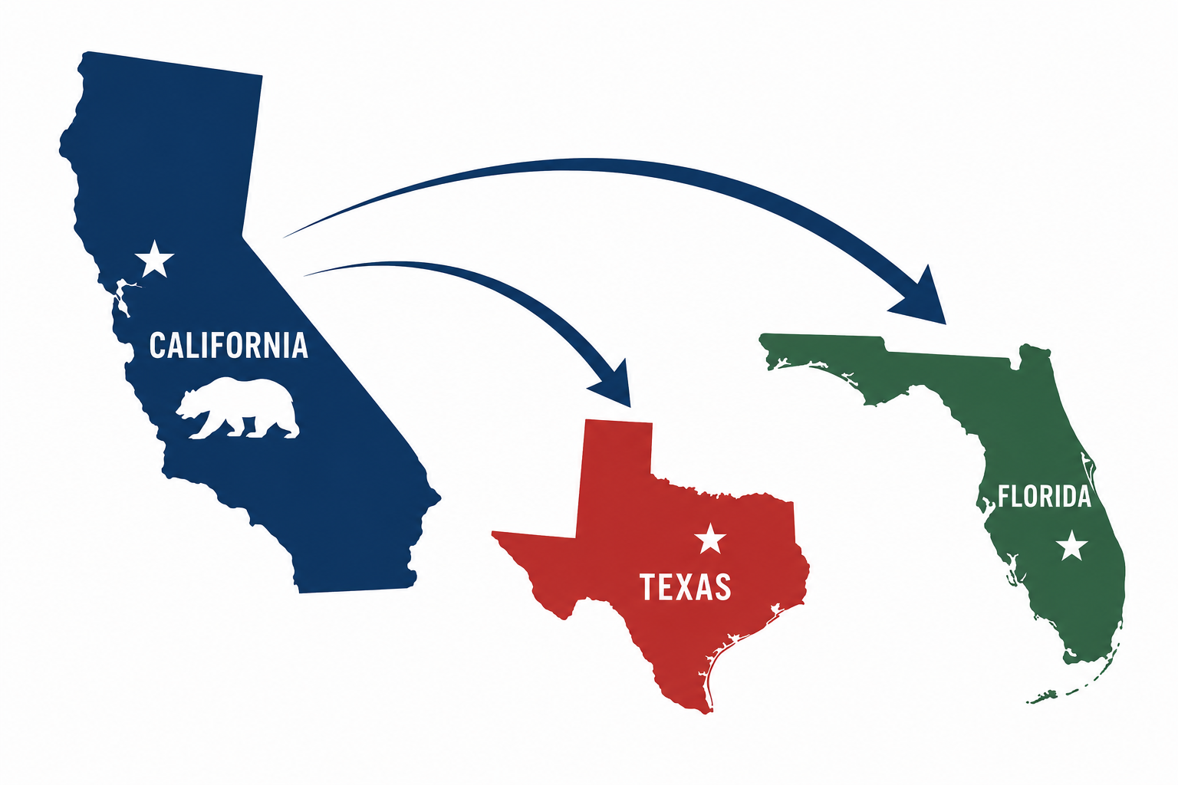
Billionaire Tax Act Potential Impact
Name | Net Worth (in billions)
Larry Page¹ | $256.2
Sergey Brin¹ | $236.4
Mark Zuckerberg | $225.1
Peter Thiel¹ | $26.7
Jan Koum | $17.1
Don Hankey¹ | $8.1
Steven Spielberg¹ | $7.0
Reed Hastings | $5.1
David Sacks¹ | $2.0
Andy Fang | $1.7
Proponents estimate $100 billion in revenue
Per a Hoover Institution study, departures, avoidance, and long-term tax base erosion could reduce actual collections to closer to $40 billion
The Supreme Court indicated that heightened scrutiny may apply to the retroactive provision
Publicly announced billionaire departures reduced the tax base by nearly 30% before signatures were submitted
Likely additional outmigration reduces expected collections to ~$40 billion
Estimated net present value:
~$24.7 billion after lost income tax revenues, with most simulations producing a negative outcome
¹Confirmed departure prior to January 1, 2026
Source: Hoover Institution, The Net Present Value of the Billionaire Tax Act (March 2026)

Slide 17

Proposition 30/55—Major Concern by Both Labor and Management
Proposition 30 was initially passed at the strong urging of Governor Jerry Brown in 2012
  The “urging” came in the form of a significant cut to K-14 funding if it did not pass
Proposition 30 was set to expire in 2019, but the income tax portion was extended to 2030 with the passage of Proposition 55 in 2016
From 2012-13 through 2024-25, Proposition 30/55 PIT made up about 6.2% of the “Big Three” revenues
The California Teachers Association (CTA) is proposing a permanent extension to Proposition 30/55 and has submitted more than 1.6 million signatures for validation
  Approximately 875,000 signatures are needed to qualify for the November ballot

Slide 18
Proposition 30/55 Revenues—Education Protection Account

Slide 19








Risks to the Economy and the State Budget
Uncertainty remains regarding future economic conditions and the potential impact of proposed tax initiatives on taxpayer behavior and revenue stability
Budget solutions rely on continued economic growth and moderation in stock market growth over the forecast period
Structural deficits persist despite strong revenue growth and improved tax collections
Insurance market instability, wildfire recovery costs, and potential climate-related disasters
Greater dependence on technology and financial markets increases volatility risk for state revenue
Federal policymaking uncertainty related to immigration, foreign trade, and geopolitical conflict
Inflation volatility due to tariffs, rising energy costs, and the Fed’s leadership transition
Medi-Cal costs and caseload pressures, along with reduced federal Medicaid spending

Slide 20




Proposition 98
The Proposition 98 minimum guarantee is up more than $6 billion over the three-year budget window
The May Revision provides significant increases in ongoing and one-time resources to LEAs
The statutory cost-of-living adjustment (COLA) is fully funded at 2.87% and an additional 1.44% increase is provided, but does not apply to all programs and comes with new spending requirements
Despite increased revenue, the May Revision continues to under appropriate the 2025-26 minimum guarantee by $3.9 billion

Slide 21
2026-27 Minimum Guarantee—From January to May
The 2026-27 minimum guarantee has grown by $1.6 billion since the Governor’s Budget
In billions | 2024-25 | 2025-26 | 2026-27 | Total
May Revision | $1.1 | $3.7 | $1.6 | $6.4
Growth over the three-year budget window is up
by a total of $6.4 billion, of which $4.6 billion is required to be deposited into the Proposition 98 reserve (PSSSA)
Ongoing spending increases by $3.2 billion, funded by growth in the minimum guarantee and funding freed up by declines in attendance
Governor’s
Budget
May
Revision

Slide 22
2025-26 Proposition 98 Settle Up
The Governor continues to under appropriate the 2025-26 minimum guarantee, but reduces the withholding amount from $5.6 billion to
$3.9 billion
  If revenue estimates materialize or exceed expectations, the May Revision indicates these funds will be distributed in the 2027 Budget Act or across multiple budget years
If the 2025-26 minimum guarantee was fully appropriated in the current year and allocated to TK-12 agencies on an equal per-ADA basis, LEAs would receive approximately
$3.9
$5.6
$654 per ADA

Slide 23
Local Reserve Cap
The Proposition 98 reserve has a balance of $10.3 billion at the end of 2025-26
The balance significantly exceeds the 3% local reserve cap trigger threshold
The local reserve cap will be operative in 2026-27
Local reserve cap
trigger threshold

Slide 24
2026-27 LCFF Funding Factors
Grade Span |  |  |  | TK-3 |  | 4-6 |  | 7-8 |  | 9-12
2025-26 Base Grant per ADA |  |  |  | $10,256 |  | $10,411 |  | $10,719 |  | $12,423
Statutory COLA—2.87% |  |  |  | $294 |  | $299 |  | $308 |  | $357
Additional LCFF Investment—1.44%¹ |  |  |  | $148 |  | $150 |  | $154 |  | $179
2026-27 Base Grant per ADA |  |  |  | $10,698 |  | $10,860 |  | $11,181 |  | $12,959
GSA |  |  |  | $1,113 |  | - |  | - |  | $337
2026-27 Adjusted Base Grant per ADA |  |  |  | $11,811 |  | $10,860 |  | $11,181 |  | $13,296
20% Supplemental Grant per ADA² |  |  |  | $2,362 |  | $2,172 |  | $2,236 |  | $2,659
65% Concentration Grant per ADA³ |  |  |  | $3,455 |  | $3,177 |  | $3,270 |  | $3,889
TK Add-on per ADA (inclusive of statutory COLA) |  |  |  | $5,704
¹Intended to offset rising costs and declining enrollment impacts, as well as absorb costs of new PPDL requirement ²Maximum amount per ADA—to arrive at LEA’s grant amount, multiply adjusted base grant per ADA by 20% and UPP ³Maximum amount per ADA—to arrive at LEA’s grant amount, multiply adjusted base grant per ADA by 65% and UPP above 55%
2.87% statutory COLA is provided for categorical programs, such as:
  Special Education
  LCFF Equity Multiplier
  Mandate Block Grant
  Child Nutrition

Slide 25



Paid Pregnancy Disability Leave
The May Revision proposes to mandate paid disability leave for medical conditions related to pregnancy
  Applies to regular certificated and classified public school employees
Leave Requirements | Leave Duration | Leave Tracking
Qualifying reasons for leave include disability due to pregnancy, miscarriage, childbirth, termination of pregnancy, or recovery from those conditions This leave does not require a minimum number of hours worked or length of service to qualify | Leave of absence is full pay up to a maximum of 14 weeks Leave may be taken before and continue after childbirth if the employee is disabled by pregnancy or other related medical conditions The length of the leave of absence is determined by the employee and the employee’s physician | Leave taken under this provision is not deducted from any other accrued paid leave Runs consecutively with other state and federal leaves of absence regulations and laws

Slide 26
Special Education Rate Increases
Special education base rate to receive historic additional investment of over $2.3 billion
Other special education rates increase by statutory COLA
$1,340
AB⁵ 602 Base Rate
Per funded ADA
$4,083.98
Low Incidence Funds
Per prior-year eligible pupil
$5,053.41
Pre-K Grant³
Per 2026-27 P-2 Grade 1 SWD⁴
$87.18
State Mental
Health Services
Per 2026-27 P-2² ADA
$21.05
Program Specialist/ Regionalized Service
Per 2019 SELPA¹ ADA
¹Special Education Local Plan Area; ²Second Principal Apportionment; ³Early Intervention Preschool Grant; ⁴Students with disabilities; ⁵Assembly Bill

Slide 27
SPED Multiyear Trends of Growing Expenditures
 | 2018-19 | 2019-20 | 2020-21 | 2021-22 | 2022-23 | 2023-24 | 2024-25
(In millions)
Total Expenditures | $16,234 | $16,650 | $16,719 | $18,297 | $20,331 | $22,507 | $24,001
Change from Prior Year | 7.8% | 2.6% | 0.4% | 9.4% | 11.1% | 10.7% | 6.6%
Federal Expenditures | $1,925 | $1,965 | $2,028 | $2,181 | $2,611 | $2,445 | $1,995
State Expenditures | $4,282 | $4,391 | $4,724 | $5,610 | $6,319 | $6,118 | $6,582
Local Expenditures | $10,339 | $10,620 | $10,286 | $10,813 | $11,801 | $13,944 | $15,424
Federal Expenditure % | 11.9% | 11.8% | 12.1% | 11.9% | 12.8% | 10.9% | 8.3%
State Expenditure % | 26.4% | 26.4% | 28.3% | 30.7% | 31.1% | 27.2% | 27.4%
Local Expenditure % | 63.7% | 63.8% | 61.5% | 59.1% | 58.1% | 62.0% | 64.3%
SWD, 0-22 | 795,047 | 804,101 | 794,788 | 791,988 | 813,529 | 851,011 | 876,250
Cost per Pupil | $20,419 | $20,707 | $21,036 | $23,103 | $24,991 | $26,447 | $27,391
ADA | 5,912,490 | 5,889,951 | 5,909,710 | 5,347,613 | 5,395,756 | 5,341,803 | 5,432,394
Local Contribution per ADA | $1,749 | $1,803 | $1,740 | $2,022 | $2,187 | $2,610 | $2,839

Slide 28
California Special Education Expenditures by Revenue Source
Declining enrollment is impacting revenue generation for all sources
Average General Fund contribution rate is the highest ever due to increasing expenditures

Slide 29
Revenue and Expenditure Historical Trends
Source: Standardized Account Code Structure (SACS) Unaudited Actuals

Slide 30
Student Support and Professional Development Discretionary Block Grant
Funding
Allowable Uses
CAUTION
May Revision increases the total state investment to $5.0 billion one-time
Proposal distributes the grant on a per-ADA basis, using 2025-26 P-2 data
Funding allocated to COEs, school districts, charter schools, and state special schools
SSC estimates $936.98 per ADA, if distributed per ADA
June 30, 2030, expenditure deadline
The total state investment may change
The Legislature has suggested other methodologies for allocating the funds, such as including UPP in the formula
The Legislature has also suggested restricting the use of at least some of the funds
Fully discretionary with certain statewide priorities highlighted for use of the funds
Professional development
Dual enrollment and career pathways
Teacher recruitment and retention
Rising costs

Slide 31
Next Steps for 2026-27 Budget Development
The only proposal codified in Education Code is the statutory COLA
  The remaining items are still subject to negotiations between the Governor and Legislature
  Changes would be reflected in your 45-day budget revision—due in mid-August
Proposal | Risk Level | Risk of Including in Your Adopted Budget
2.87% Statutory COLA | Nearly Zero | Statutory COLA is a known number as of April 2026
1.44% Additional LCFF Investment | Nearly Zero | Funding for PPDL requirement and rising costs—while the policy rationale is likely unopposed, the funding is subject to negotiation between the Governor and Legislature
Discretionary Block Grant | Medium | The ultimate funding level, allocation method of per ADA versus weighted on UPP, and level of flexibility are still subject to negotiation between the Governor and Legislature
LREBG | Low | Was not referenced in the May Revision, which means the proposal is unchanged from Governor’s Budget
Special Education Base Rate | Low | There is broad support for this increase, but the ultimate funding level is still subject to negotiation between the Governor and Legislature

Slide 32
Proposed
2026-27
Adopted Budget

Slide 33
Budget Projections
Key Factors
  Enrollment
  Attendance
  Unduplicated Pupil Percentage (UPP)
  LCFF Increase/Decrease
  Position Control/Hiring
  STRS/PERS increases
  Special Education Increases
  Collective Bargaining/Negotiations
  Don’t use one-time dollars to justify paying for ongoing expenditures
RAB 1200
(Chapter1213/1991)
and AB 2756
(Chapter 52/2004)
Projections are expected to change as various factors change
Assumptions +
Today’s Decisions
= Projections
Projections are not predictions

Slide 34
SACS Budget Forms
Budget Certification - Positive
Executive Summary and Internal Budget Documents for all Funds
Adopted Budget Reports for all Funds
Cash Flow Projection
Average Daily Attendance
Multi-Year Projection – General Fund
Summary of Interfund Activities
Criteria and Standards

Slide 35
Other Funds
Fund 08: Student Activity Special Revenue Fund
Fund 11: Adult Education Fund
Fund 12: Child Development Fund
Fund 13: Cafeteria Fund
Fund 14: Deferred Maintenance Fund
Fund 20: Special Reserve Fund for Post-Employment Benefits
Fund 21: Building Fund
Fund 25: Capital Facilities Fund – Developer Fees
Fund 35: County School Facilities Fund
Fund 40: Special Reserve Capital Outlay Fund

Slide 36
2026-27 General Fund
9.82%
NOTE: Meets Board Policy intent for Economic Uncertainties
No structural deficit; using categorical carryover funds

Slide 37
2026-27 Ending Fund Balances
Restricted

Slide 38
2026-27 General Fund Revenues

Slide 39
2026-27 Components of LCFF (not including Charters)
Total LCFF Funding:
$372,230,262
Home-to-School Transportation
Economic Recovery Target (ERT)
12-13 Award Level
Targeted Instructional Improvement Block Grant
Add-ons
Necessary
Small
School
$15,049,075
Transitional Kindergarten (TK) Add-on
Unduplicated Pupil Count
English Learners
Low Income
Foster Youth
Concentration Grant*
90.19%
Supplemental Grant
Supplemental & Concentration
90.19%
Grade Span Adjustment
$103,702,098
Adjusted Base Grant
Average Daily Attendance
Base Grant
$253,479,089
Necessary Small School Allowance
21,243.00
$-
*Unduplicated Pupil Percentage must be above 55% to receive Concentration Grant funding

Slide 40
2026-27 LCFF Revenue
 | Twin Rivers | Creative Connections | Smythe Academy | Westside Prep Charter | Total
 | Estimated | Estimated | Estimated | Estimated
 | 2026-27 | 2026-27 | 2026-27 | 2026-27
2026-27 Estimated LCFF Entitlement | $372,230,262 | $12,358,913 | $15,863,016 | $6,321,933 | $406,774,124
Base Funding | $268,528,164 | $9,429,354 | $11,242,101 | $4,698,156 | $293,897,775
Supplemental/Concentration | $103,702,098 | $2,929,559 | $ 4,620,915 | $1,623,777 | $112,876,349
Estimated Unduplicated Pupil % | 90.19% | 78.61% | 93.11% | 82.72%
(3 year rolling average)
(EL, low income and/or foster youth)

Slide 41
Student Change –
By Grade
2023-24 through 2025-26 growth is due to the additional months added for TK students and the new housing development in Northlake area.

Slide 42
LCFF “Funded” ADA vs P-2 ADA (Includes Charters)

Slide 43
Revenue Sources
2026-27 Adopted
LCFF Base
LCFF S/C
Federal
State
Local & Other
Salaries
Statutory taxes
Health benefits
Retiree health benefits
Department budgets
School budgets
Instructional Materials
Utilities
Property and Liability Insurance
Routine Restricted Maintenance
Special Education
Visual and Performing Arts
Additional Counselors
Additional Psychologists
Nurses
Additional Vice Principals
WL, NS & DLI teachers
Student Engagement/Field Trips, Athletics
Additional Facilities/Custodians
Class Size Reduction
Yard and Duty
Career and Technical Education
Full-Day Kindergarten
Content Area Coaches
English Learner Program
And more
Title I, Part A, Basic
Title II, Education Quality
Title III English Learner Program
Title IV – Student Support & Academic Enrichment
Special Education
Other Federal Programs
Special Education
Mental Health
Expanded Learning Opportunity Program
After School Education and Safety
Mandated Cost
Lottery
Transportation
Career and Technical Education
Art sand Music in Schools
LCFF Equity Multiplier
CalSTRS
Other State Programs
Transfers In (Indirect from other funds)
Interest
Oversight Charter Fees
Medi-Cal Billing
Other Local Revenue
$9.6
million
$295.7 million
$112.9 million
$30.6 million
$118.3 million

Slide 44
Estimated Actuals 2025-26 vs.
Proposed Budget 2026-27
 | Increase/(Decrease) (In Millions)
Local Control Funding Formula (LCFF)
Estimated Funding 2025-26 | $380.7
Estimated Funding 2026-27 | $408.6
INCREASE | $27.9
State Revenue
Decrease Lottery | ($0.1)
Increase Other State Revenue | $0.5
Other Local Revenue
Decrease interest income | ($1.4)
Decrease miscellaneous income | ($1.0)
Decrease revenue from independent charters | ($1.0)
TOTAL | $24.9
Revenue Changes - Unrestricted

Slide 45
2026-27 General Fund Expenditures

Slide 46
TRUSD LCAP Expenditures by Goal
Goal 1
Increase Academic Achievement and Decrease Disproportionalities
Goal 2
Ensure All Students Graduate College and Career Ready
Goal 3
Improve Culture and Climate through increased Student Engagement
Goal 4
Increase Parent Engagement
Goal 5
Provide Facilities that are Clean, Safe and Conducive to Student Learning
Goal 6
Increase ELA and Math Academic Achievement for Students with Disabilities
Goals 7-10
Equity Multiplier Focus Goals
Goal 11
Recruit, Hire, and Retain High Quality Staff

Slide 47
Estimated Actuals 2025-26 vs.
Proposed Budget 2026-27
Expenditure Changes - Unrestricted
 | Increase/(Decrease) (In Millions)
Certificated Salaries Step & Column, 3% salary increase, 6th period pay increase, class size overage payment increases, hour rate increase, & teachers for Northlake School and TK No teacher offset to one-time block grant | $13.6 $5.1
Classified Salaries Step & Column, 3% salary increase & positions for TK classes | $2.6
Employee Benefits Health benefits increase, PERS increase, & increase from salary increases | $9.7
SUBTOTAL | $31.0

Slide 48
Estimated Actuals 2025-26 vs.
Proposed Budget 2026-27 (Continued)
Expenditure Changes - Unrestricted
 | Increase/(Decrease) (In Millions)
Materials & Supplies Increase for textbook adoption | $1.9
Services Removed various one-time departmental service agreements | ($3.0)
Capital Outlay & Other Facility Projects Less Indirect from categorical programs | $3.3 $0.5
Other Outgo Transfers to Fund 40 reduced | ($16.1)
TOTAL | $17.6

Slide 49
Projected LCFF Funding Per ADA

Slide 50
Multi-Year Projection (MYP) Assumptions
 | 2025-26 | 2026-27 | 2027-28 | 2028-29
Average Daily Attendance (ADA) - Funded (including charters) | 22,805 | 23,416 | 23,463 | 23,463
Funded LCFF ADA | Prior Year | Current | Current | Current
Statutory COLA & Augmentation | 2.30% | 2.87% + 1.44% (4.31%) | 3.30% | 3.09%
Step and Column - Certificated | 1.4% | 1.4% | 1.4% | 1.4%
Step - Classified | 1.85% | 1.85% | 1.85% | 1.85%
STRS Employer Rates | 19.10% | 19.10% | 19.10% | 19.10%
PERS Employer Rates | 26.81% | 26.40% | 26.80% | 25.90%
Lottery Revenue – Unrestricted per ADA | $190 | $190 | $190 | $190
Lottery Revenue – Restricted per ADA | $82 | $82 | $82 | $82
California Consumer Price Index (CPI) | 3.25% | 3.76% | 3.18% | 2.76%

Slide 51
Additional MYP Assumptions and Details
2027-28
LCFF
  “Funded” and actual ADA increase of 50
  No change to Charter ADA
Interest income reduced $500k
$8.4M contribution increase for special education (decrease to revenue)
Salaries/Benefits
  No salary increase
  8% health contribution increase
  2 additional teachers
3% increase for inflation
$4.0M less toward Capital Outlay Projects
One-time expenditure carryovers removed
2028-29
LCFF
  No change to TRUSD ADA
  No change to Charter ADA
Interest income reduced $1M
Salaries/Benefits
  No salary increase
  8% health contribution increase
  $2.4M Certificated positions shifted from one-time funds back to unrestricted
$1.8M increase service agreements shifted from one-time funds back to unrestricted
3% increase for inflation
One-time expenditure carryovers removed
General Fund
1% salary increase = $3.4M

Slide 52
General Fund Multi-Year Projection (MYP)
(In Millions) | Estimated Actuals 2025-26 | Proposed Budget 2026-27 | Projection 2027-28 | Projection 2028-29
Beginning Fund Balance - July 1 | $161.9 | $122.8 | $99.1 | $94.1
Revenues | $554.5 | $567.0 | $574.7 | $587.8
Expenditures (Including Transfers) | $593.6 | $590.7 | $579.7 | $587.5
Surplus/(Deficit Spending) | ($39.1) | ($23.7) | ($5.0) | $0.3
Ending Fund Balance | $122.8 | $99.1 | $94.1 | $94.3
Components of Ending Fund Balance
Nonspendable | $2.4 | $2.4 | $2.4 | $2.4
Restricted | $62.5 | $37.8 | $26.1 | $24.0
Committed | $0 | $0 | $0 | $0
Assigned | $838k | $838k | $838k | $838k
Unassigned – Economic Uncertainties* | $57.0 | $58.0 | $64.7 | $67.0
 | 9.60% | 9.82% | 11.16% | 11.40%
*Meets Board Policy Intent for Economic Uncertainties
NOTE: No structural deficit; using carryover fuds.

Slide 53
General Fund Multi-Year Projection (MYP)
Ending Fund Balance

Slide 54
One-time Block Grant Funds
One-time Learning Emergency Block Grant (LREBG) funds are available through 06/30/2028.
  The $2.4M of positions and $1.8M in service agreements paid by one-time LREBG funds (providing a surplus to unrestricted funds) will shift to unrestricted funds in 2028-29.
One-time 2025-26 SS & PD Block Grant funds are discretionary and available through 6/30/2029 but are budgeted to be spent by 6/30/2027.
Another round of one-time SS & PD discretionary Block Grant funds are proposed for 2026-27 and will be used for technology hardware replacements, a bus, and facility projects.

Slide 55
Looking Ahead
With additional revenue and budget adjustments, including incorporating compensation increases, 2026-27 presents an essentially balanced budget year for Unrestricted General Fund
  Restricted funds are being spent down and there are some one-time unrestricted expenditures
However, economic indicators heed caution
  The State is still operating at a deficit and using one-time money to plug ongoing holes, shortchanging Prop 98
  Lots of economic uncertainty based on inflationary pressures and potential November ballot measures
Beyond 2026-27
  Some surplus for Unrestricted General Fund
    We will see what final budget bill from State means for TRUSD
    Also, November ballot measure results
June 23rd: Adoption of Proposed 2026-27 Budget
August: TRUSD 45 Day Budget Revision if the State Adopted budget is materially different
September: 2025-26 Unaudited Actuals and 2026-27 Budget Update
  Will have State Budget Act and revised revenue projections
December: First Interim will be presented to the Board
  Actual Carryover and restricted ending fund balance amounts from 2025-26 will be included

Slide 56
Thank You!
Questions?

Slide 57
Appendix: Acronyms
(A) – Actual
AB – Assembly Bill
ADA – Average Daily Attendance
AI – Artificial Intelligence
CA – California
CALPADS – California Longitudinal Pupil Achievement Data System
CalSTRS – California State Teacher Retirement System
CapEx – Capital Expenditures
COE – County Office of Education
COLA – Cost-of-Living Adjustment
CPI – Consumer Price Index
CTA – California Teachers Association
DLI – Dual Language Immersion
DOF – Department of Finance
(EA) – Estimated Actuals
EL – English Learner
ELA – English Language Arts
ERT – Economic Recovery Target
FED – Federal Reserve
FRED – Federal Reserve Economics Data
FY – Fiscal Year
GSA – Grade Span Adjustment
GDP – Gross Domestic Product
LAO – Legislative Analyst's Office
LCAP – Local Control and Accountability Plan
LCFF – Local Control Funding Formula
LEA – Local Education Agency
LREBG – Learning Recovery Emergency Block Grant
M – Million
MTSS – Multi-Tiered System of Supports
MYP – Multi-year Projection

Slide 58
Appendix: Acronyms
N/A – Not Applicable
NS – Native Speaking
NASDAQ - National Association of Securities Dealers Automated Quotations
OPEC - Organization of the Petroleum Exporting Countries
(P) – Projected
P-2 – Second Principal Apportionment
PD – Professional Development
PERS – Public Employees Retirement System
PIT – Personal Income Tax
PPDL – Paid Pregnancy Disability Leave
PROP – Proposition
PSSSA – Proposition 98 Reserve
REU – Reserve for Economic Uncertainties
S&P – Standard and Poor’s
SACS – Standardized Account Code Structure
SBAC – Smarter Balanced Assessment Consortium
SCOE – Sacramento County Office of Education
SELPA – Special Education Local Plan Area
SPEC. ED. – Special Education
SS – Student Support
SSC – School Services of California
STRS – State Teachers Retirement System
SWD – Students with Disabilities
TK – Transitional Kindergarten
TRUSD – Twin Rivers Unified School District
UCLA – University of California, Los Angeles
UPP – Unduplicated Pupil Percentage
U.S. – United States
WL – World Language

